Slide 1
Renal Regulation
Prof. Deepthi de Silva
Department of Physiology

Slide 2
At the end of this lecture you should be able to
Outline the neural regulation of the kidney
List the hormones involved in renal regulation
Outline the role of the kidney in regulating serum calcium and haemoglobin
Outline the mechanism of secretion and action of renin, angiotensin & aldosterone; atrial natriuretic peptide, antidiuretic hormone and prostaglandins
Outline the regulation of the extracellular fluid volume, osmolality, sodium and water balance

Slide 3
Neural Regulation-
Sympathetic noradrenergic fibres
(& circulating catecholamines)
1. Afferent & efferent arterioles
  Vasoconstriction can reduce renal blood flow
2. Tubules- increases sodium reabsorption
in nephron (PCT, thick ascending, DCT)
3. Increases renin secretion

Slide 4
Hormonal regulation
1. Renin- Angiotensin system
Involves the juxtaglomerular apparatus
Renin – enzyme from JG cells of afferent arterioles
Hormone system for regulation of GFR and circulating volume
Increase blood pressure
Na⁺ and water
retention

Slide 5
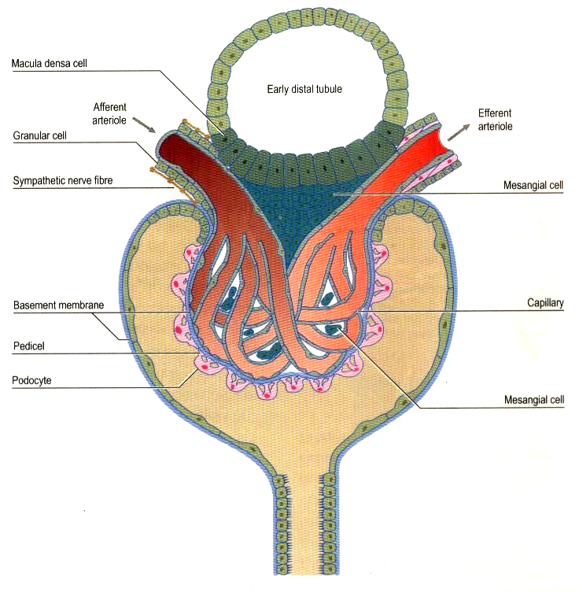
Macula Densa cells
Early distal
tubule
Afferent arteriole
Efferent arteriole
Granular cells
Sympathetic nerve
fibres
Mesangial cells
Basement membrane
Capillary
Pedicle
Podocyte
Mesangial cells

Slide 6
Stimuli for Renin secretion
Macula densa detecting low Na & Cl ions in DCT
Increased sympathetic nerve stimulation
Reduced renal perfusion pressure in the afferent arteriole
Prostaglandins
Clinical situations causing a fall in the central venous pressure

Slide 7
Inhibition of Renin release
Angiotensin II
Vasopressin?
Increased perfusion pressure
Increased [NaCl] in DCT
Reduced sympathetic activity

Slide 8
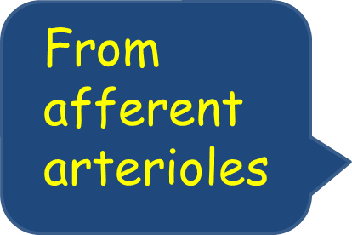
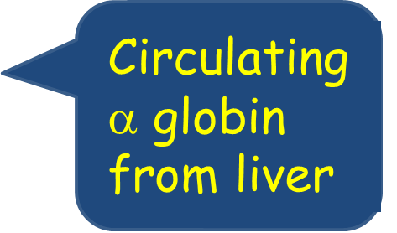
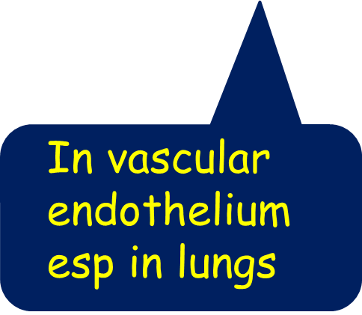
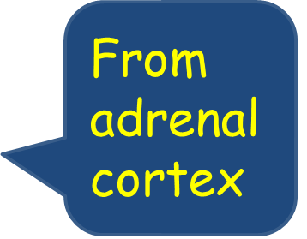
Renin- Angiotensin- Aldosterone system
ANGIOTENSINOGEN
Renin
ANGIOTENSIN I
Angiotensin converting
enzyme (ACE)
ANGIOTENSIN II & III
ALDOSTERONE

Slide 9
Functions of Angiotensin II
Vasoconstriction of vessels in systemic circulation (increase total peripheral resistance, venous return) → Rise in blood pressure
In the kidneys
  Increase Sodium reabsorption in tubules
  Increase efferent arteriolar constriction
  Reduces GFR by mesangial cell contraction
3. Stimulates aldosterone secretion
4. Stimulates antidiuretic hormone secretion
5. Stimulates thirst (acting on hypothalamus)

Slide 10
Angiotensin II (III, IV)
Raised plasma [K+]
Adrenal Cortex
(zona Glomerulosa)
Salt & water retention
ALDOSTERONE
Principle cells of DCT/ CD
Increase Na+ reabsorption
Increase K+ / H+ excretion

Slide 11
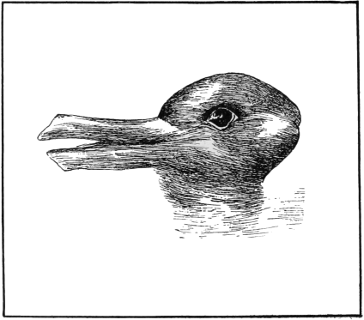
Bird or Mammal?

Slide 12
Other hormones
Atrial Natriuretic Peptide (ANP)
  Increase salt and water loss
Anti diuretic hormone
  Increase water reabsorption
Prostaglandins
  Locally acting vasodilator
Endocrine aspects of the kidney
  Calcitriol
  Erythropoeitin

Slide 13
2. Atrial Natriuretic Peptide (ANP)
Stretch of atrium
Stretch of ventricles
(in cardiac failure)
ANP effects opposite to the Renin- Angiotensin system
Release of ANP
Vasodilatation of arterioles/ venules
Increase capillary permeability
Reduced Na+ reabsorption in tubules
Inhibition of renin secretion
Inhibition of AT II and catecholamine effects
i.e. Increase Na+ and water loss in kidney

Slide 14
2. Atrial Natriuretic Peptide (ANP)- mechanism of action
Rise in circulating volume
Increase stretch of atria
ANP effects opposite to the Renin- Angiotensin system
Release ANP
Promote Na+ and water loss
Fall in circulating volume

Slide 15
In cardiac failure the plasma ANP at high levels
Measure plasma Brain Natriuretic peptide (BNP) levels to diagnose and monitor cardiac failure
  Released from ventricles

Slide 16
3. Antidiuretic hormone (ADH)
[Vasopressin]
Synthesised in hypothalamus and released from posterior pituitary
As plasma osmolality increases (>285mOsm/kg), ADH secreted to increase water reabsorption in collecting ducts
  very sensitive (1% rise cause ADH release)
Circulating volume or pressure decreases, ADH also secreted; causes vasoconstriction resulting in increased blood pressure
  Volume fall of >10% stimulates ADH release

Slide 17
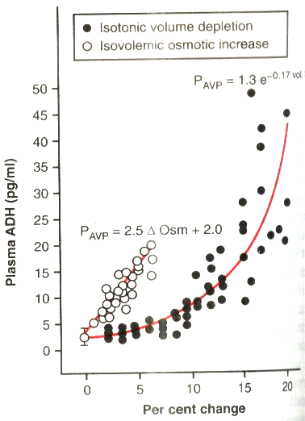
Isotonic volume depletion
Isovolaemic osmotic increase
Plasma ADH (pg/ml)
Percent change

Slide 18
Other stimuli for ADH secretion
Pain
Nausea
Surgical stress
Emotions
Alcohol reduces ADH secertion

Slide 19
Antidiuretic hormone (ADH)
Fall in arterial pressure/
Blood volume
Rise in plasma osmolality
Increased osmoreceptor stimulation
Reduced baro/ stretch receptor stimulation
From posterior pituitary
Release ADH
Water absorption in collecting ducts (causes fall in plasma osmolality)
Vasoconstriction of systemic arteries (causes rise in BP)

Slide 20
ADH- mechanism of action
V1 receptors in arterial wall
  cause vasoconstriction
  Results in increasing systemic blood pressure
V2 receptors in collecting duct
  inserts water channels in the luminal part to enable water reabsorption
  Increases urea permeability in medullary part of CD (activates urea transporters)

Slide 21
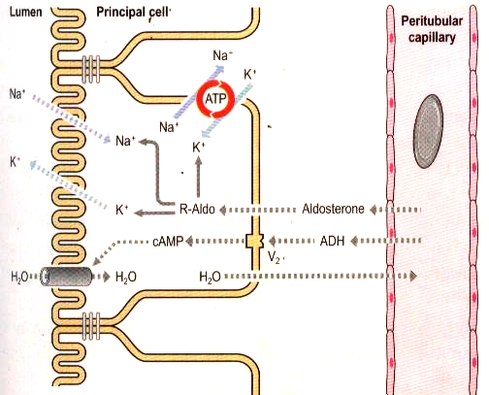

Slide 22
Diabetes insipidus
High urine output
Dilute urine
Plasma osmolality
normal or high
Thirst
Cranial form
  ADH deficiency due to hypothalamic disease
Nephrogenic
  ADH present but unable to act on its target cells
How can you identify which type it is?

Slide 23
What happens if there is an excess of ADH?
Syndrome of inappropriate ADH secretion
  Low serum osmolality
  Inappropriately high urine osmolality
  Low Na+ in plasma
  Expansion of ECF volume
Read up vasopressin escape

Slide 24
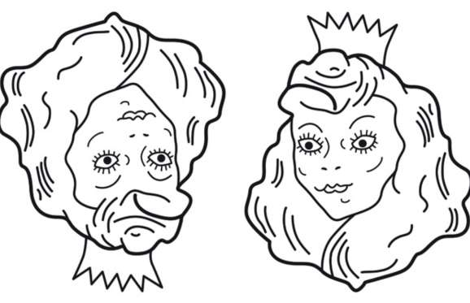
Mother or Daughter?

Slide 25
Why is vasopressin given to patients with bleeding from oesophageal varices?

Slide 26
4. Prostaglandins
Locally acting
Synthesis stimulated by sympathetic activity
Cause renal vasodilatation
Protects kidney from ischaemia (caused by excessive vasoconstriction)
Non steroidal anti-inflammatory drugs reduce prostaglandin synthesis
Can this be dangerous??

Slide 27
5. Erythropoeitin
Revise blood module lectures
EP secretion stimulated by hypoxia
Act on bone marrow to stimulate erythrocyte formation
Low EP levels in chronic renal failure cause anaemia– treated with EP injections

Slide 28
6. Calcium metabolism and the kidney
Vitamin D3 (Cholecalciferol)
Liver
25 OH-Cholecalciferol
Parathyroid
hormone (PTH)
Kidney
Calcitriol
Increase plasma Ca++
Fall in plasma PO₄
-Gut Ca++ absorption
-Bone reabsorption
-Renal reabsorption

Slide 29
The Role of the Kidney in Regulating the Extracellular fluid Compartment

Slide 30
Regulation of ECF
ECF Osmolality
Regulated by maintaining water balance
Water intake and excretion
ECF volume
Regulated by maintaining sodium balance
Sodium intake and excretion

Slide 31
Regulation of Osmolarity
Plasma osmolarity increases
Excess sweating, diarrhoea etc
Hypothalamus
Stimulation of osmoreceptors
Increased ADH secretion
Thirst stimulation causes drinking
Increased water reabsorption
Collecting ducts
Increased ECF water
Reduction in osmolarity

Slide 32
Regulation of the extracellular fluid volume
Dependent on NaCl
  Adding a hypertonic solution to plasma will increase its osmolality
  Rise in plasma osmolality stimulates osmoreceptors
  This causes increase in ADH secretion & increased thirst
  Increase in ECF water and a rise in ECF volume
Fall in ECF Na+ will cause a fall in ECF volume

Slide 33
Regulation of the ECF volume
Regulated by controlling Na+ excretion
ECF volume fall (& reduced BP) is compensated by CVS and renal mechanisms
Renal mechanisms for increasing ECF volume include
Neural reflexes via Baroreceptor/low volume receptors to ↑ sympathetic discharge
  ↑ renin secretion & ↑ Na+ reabsorption (PCT)
Hormonal
  Stimulate the renin- angiotensin- Aldosterone system, ↑ ADH secretion

Slide 34


The End

Slide 35

Hypertonic
solution
Increase tonicity
Isotonic
solution
Increase in volume
Isotonic
Osmoreceptor stimulation
→ ADH secretion
→ Thirst & drinking

Slide 36
Juxtaglomerular Apparatus
Macula densa cells of DCT able to detect composition of fluid
    Reduced renal flow reduces hydrostatic pressure in peritubular capillaries
    This increases water & Na+ reabsorption from proximal tubule
  Because of increased Na+ reabsorption, the load of Na+ delivered to the DCT is reduced
  Macula densa stimulates renin secretion when DCT detects a low [NaCl]

